Slide 1
Machine Learning Theory Project Powerpoint Presentation Topic - Sentiment Analysis for Amazon - Product Reviews
Group Members :
Rajat Kumar 20171059
Ashutosh Kumar 20174087
Satya Prakash Yaadav 20174179
Bhupendra Kumar Prajapati 20174122

Slide 2
INTRODUCTION
Our project is based on topic, which is called sentiment analysis , which is given a bunch of text we can computationally study people’s opinions, appraisals, attitudes, and emotions toward entities and their attributes.
Applications of this technique are diverse. To find and monitor opinion sites on the web and filter the information contained in them remains a difficult task because of the proliferation of diverse sites.

Slide 3
The dataset used consists of customers’ reviews and ratings, which we got from Consumer Reviews of Amazon products. We extracted the features of our dataset and built several supervised models based on that.
These models include not only traditional algorithms such as Naive Bayes, linear support vector machines, K-nearest neighbours etc., but also deep-learning metrics such as recurrent neural networks and lstm networks.
We compared the accuracy of these models and got a better understanding of the polarised attitudes towards the products.

Slide 4
Ongoing Research
Multiple studies about sentiment analysis on Amazon.com reviews have been done.
In these studies conventional Machine Learning (ML) like Naive Bayesian (NB), Support Vector Machine (SVM), decision trees or logistic regression are used which resulted in relatively good performances.
A sentiment analysis of reviews of Amazon beauty products has been conducted in 2018 by a student from KTH and he got more accuracy with the SVM and NB classiﬁers. He found that for large amount of data, SVM is better than Naive Bias. He also focused on summaries of the reviews which are more informative and got higher accuracy.
Xing Fang and Justin Zahn analyzed diﬀerent categories of Amazon products (beauty, book, electronic, and home) with 3 diﬀerent classiﬁers: NB, SVM and Random Forest. They reached the conclusion that Random Forest usually provided them with more accurate results. They also found that SVM was performing better than NB for larger data sets.

Slide 5
Some work has also been done about binary classiﬁcation with LSTM network.
Zhenxiang Zhou and Lan Xu analyzed the usefulness of Amazon food reviews with LSTM and feed-forward neural (FFN) networks. The results have shown that LSTM outperformed FFN, and that the accuracy was quite good.
Reviews of Amazon books have also been analyzed, using LSTM algorithm in 2017. They compared two recurrent neural networks (RNN): Gated Recurrent Unit (GRU) and Bidirectional LSTM. The bag-of-word algorithm was used for feature extraction. With a data set of more than 210 000 reviews, they got the best accuracy with the LSTM algorithm.

Slide 6

1) METHODOLOGY
Naive Bayes - It is one of the most common generative learning algorithms for classification problems. In this algorithm we assume that x’s is conditionally independent given y, which is known as Naive Bayes assumption.
We also incorporated Laplace Smooting in our model to make it work better. The prediction of an example is given by the formula below:

Slide 7
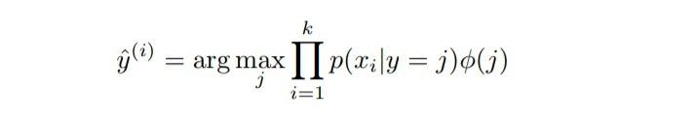
It takes an array of non-negative integers, and models p(xi|y) with the multinomial distribution.
The second way of representing review texts using the glove dictionary, we chose to model p(xi|y) with Gaussian distribution because inputs are no longer non-negative.

Slide 8

2 K-nearest neighbours - K-nearest neighbors (KNN) is a non-parametric classification method.
In making a prediction, this method first looks for the K nearest neighbours of the input. Then, we will assign the majority of that n neighbours’ class. The distance between them is the euclidean distance whose distance are measured by the similarity between the data points.
The equation given shows the mathematical representation of the KNN algorithm. The general idea of KNN is that if the inputs are similar to each other , then the output would be the same.In our project we have the numbers of nearest neighbours K to 3.

Slide 9
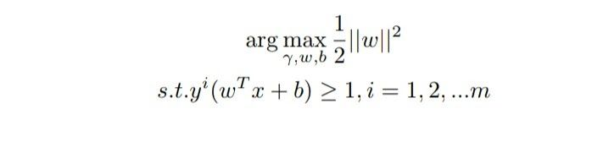
3 Linear Support Vector Machine :
It’s a method which is generally used to create classifier which separates the dataset.It is used on labelled dataset.
Let we have given two types of given points circles and squares then it tries to maximise the minimum distance from one point to other, or we can say it maximises the margin. The optimisation problem that SVM solves is given below:

Slide 10
4 Logistic Regression :
Logistic regression uses an equation as the representation , very much like linear regression .
Input values (x) are combined linearly using weights or coefficient values to predict an output value (y).
Here difference from linear regression is that the output value being modelled is a binary value (0 or 1) rather than a numeric value in linear regression.
The logistic regression equation :
y = e^(b0 + b1*x) / (1 + e^(b0 + b1*x))
y = predicted output b0 = bias or intercept term b1 = coefficient x = input value
Each column in your input data has an associated b coefficient (a constant real value ) that must be learned from your training data .

Slide 11
5 Decision Tree:
It is a decision support tool that uses a tree-like graph or model of decisions and their possible consequences , including chance event outcomes , resource costs , and utility.
It is one of the only algorithm that contains conditional control statements.
It is having a flowchart-like structure in it each of the internal node represents a test on an attribute and each branch represents the outcomes of the same. The leaf nodes represents a class label. The classification rules are given by the path from the root to the leaf node.

Slide 12
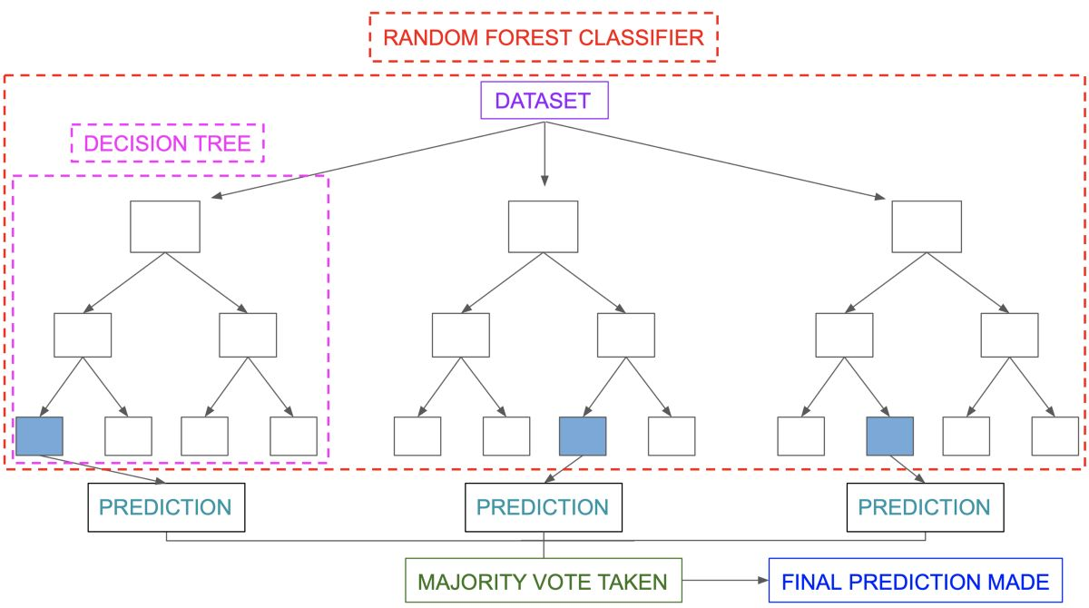
6 Random Forest Classifier:
It is a tree - based learning algorithm . The Random Forest Classifier is a set of decision trees from a random selected subset of the training set. It combines the votes from different decision trees to decide the final class of the test object.

Slide 13
7 Ensemble Approach :
Ensemble methodology is focused on combining above six mentioned classification algorithms to enhance the results.
Training and testing data had been preprocessed and cleaned before it was passed as the input of machine learning algorithms.
The ensemble approach is used to classify the review. The ensemble approach is also known as the majority voting or voting classifier.
Every model makes a prediction analysis at each instance, and the final output prediction is the one that receives more than 50 per cent of the votes. If none of the predictions gets more than half of the votes, the ensemble method could not make a stable prediction for this instance.

Slide 14
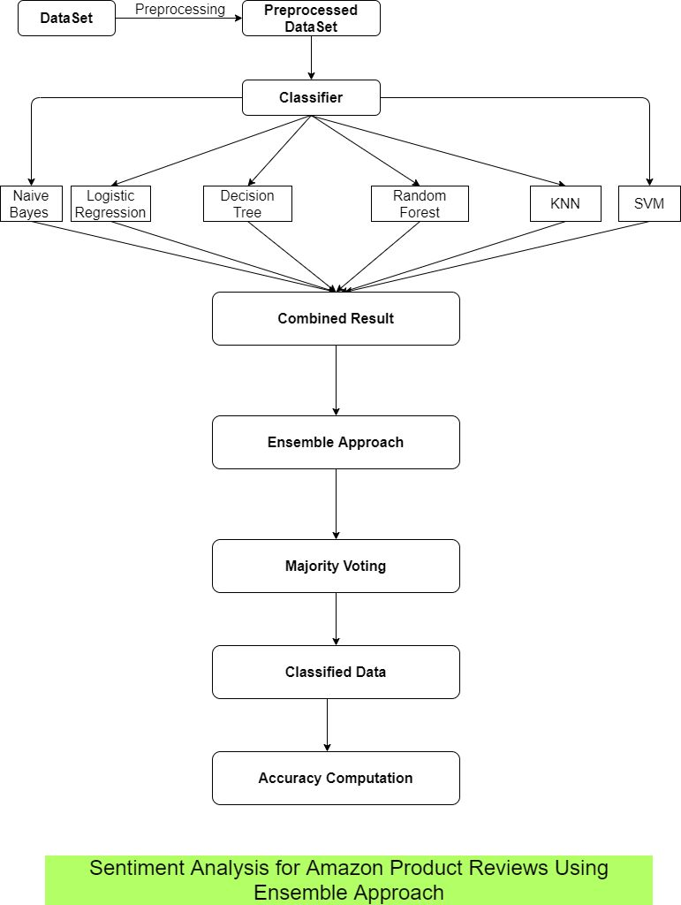

Slide 15
2) METHODOLOGY
1 LSTM (Long Short Term Memory) :
Long Short Term Memory(LSTM) is a unit of Recurrent Neural Network(RNN). Generally a LSTM unit is consists of cells, an input, output and forget gate.
The cell remembers values over arbitrary time intervals and the three gates regulate the flow of information into and out of the cell. Therefore, these networks are well-suited to classifying, processing and making predictions based on time series data.
In this project, we used the LSTM with 300 hidden units and then used a dense net with softmax as the activation function to predict these five classes.
When it comes to LSTM, the result is a little bit better than other conventional machine method due to the bigger amount of the parameters.

Slide 16
DATA SET DESCRIPTION
1 Data Preprocessing :
Our dataset comes from Consumer Reviews of Amazon Products.
Each example includes the type, name of the product as well as the text review and the rating of the product. To effectively utilise the data, first, we extract the rating and review column since these two are the essential part of this project.
We found that some data points had no ratings when we went through the data. After eliminating those examples, we have 34620 data points in total. In Figure 2, it shows that we have five classes - rating 1 to 5 as well as the distribution among them.

Slide 17
2 Features :
There are four features in Amazon consumer reviews dataset, reviews.rating as rating given by consumer, reviews.text as feedback of product by consumer, reviews.title as description of product by company, reviews.username as name of the product.

Slide 18
RESULT
We have followed two strategies to compute the accuracy over our review dataset :-
First, we have applied different classifiers which include KNN, Linear SVM, Logistic Regression, Decision tree, Random Forest, and at last using majority voting we have applied an ensemble approach. We have calculated the accuracy of each classifier on the given dataset individually and compared it with the ensemble approach.
The proposed system produces better accuracy than the existing system. However, the accuracy level varies with the total number of the classifiers we are combining to get a predicted output of the review.
If the accuracy is higher, we can use the system for the recommendation for the users.

Slide 19
Second, we have approached the problem using LSTM which is a unit of RNN (Recurrent Neural Networks).
As the results on the test data shows, LSTM networks are the most suitable for binary sentiment analysis on amazon product reviews.
Based on the results on the evaluation datasets, we can conclude that LSTM performs very well (accuracy > 0.90) for binary classification, and that does not depend strongly on the type of product where the reviews come from. LSTM network both performs accurate results for positive and negative classes.
Recurrent neural networks with LSTM outperforms the Ensemble algorithm. The reason behind this is that in RNN with LSTM we have memory storage for saving previous state results(i.e. It undergoes backpropagation) for more accurate prediction which is not present in ensemble algorithm.

